Slide 1
Strategy and Tactics for the
Anti-Capitalist Struggle
Southern Workers Assembly School
June 6, 2021

Slide 2
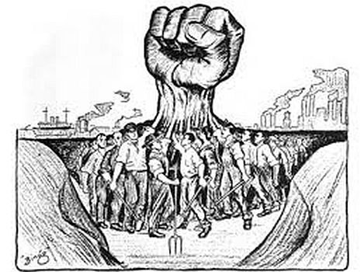
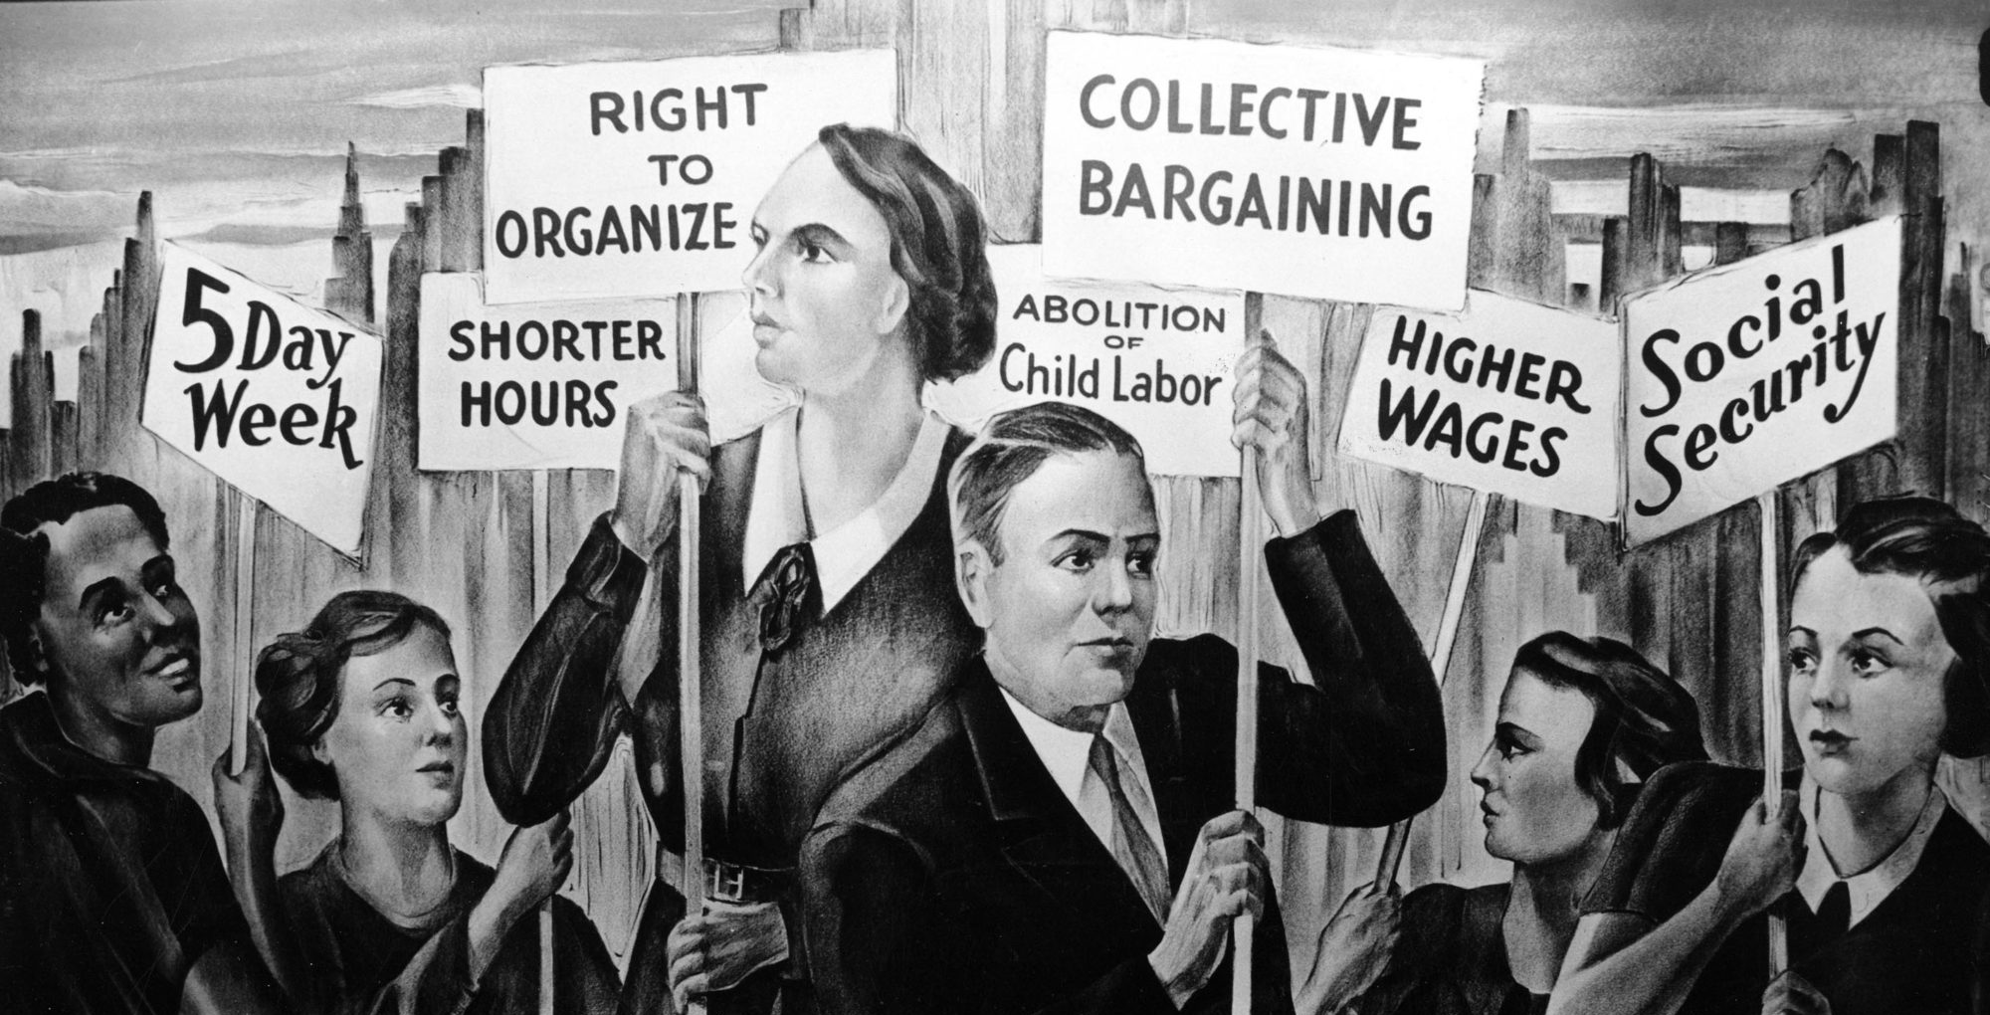
What does it mean to be
anti-capitalist?
First: Know what capitalism is
Second: Unite the working class
Third: Have a class analysis of state power
Fourth: Have a plan to implement struggle

Slide 3
Review of Session #1
What is capitalism and how do you know that
Private property:
The capitalist class owns the means of production, tools/ technology and natural resources
Labor:
The masses of people are forced to sell their labor power in order to earn money to live
Government:
Capitalists control the government and make rules that serve themselves
Profit:
Wealth is accumulated based on exploiting labor backed up by government laws
Classes:
Wealth polarizes, rich and poor, with a middle class in between

Slide 4
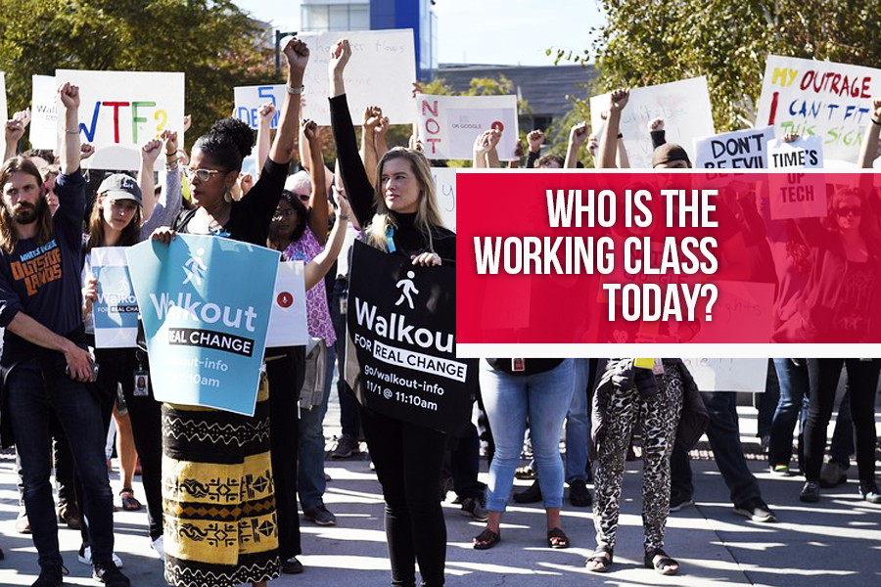
Review of session #2
What is the working class and how to unite it

Slide 5
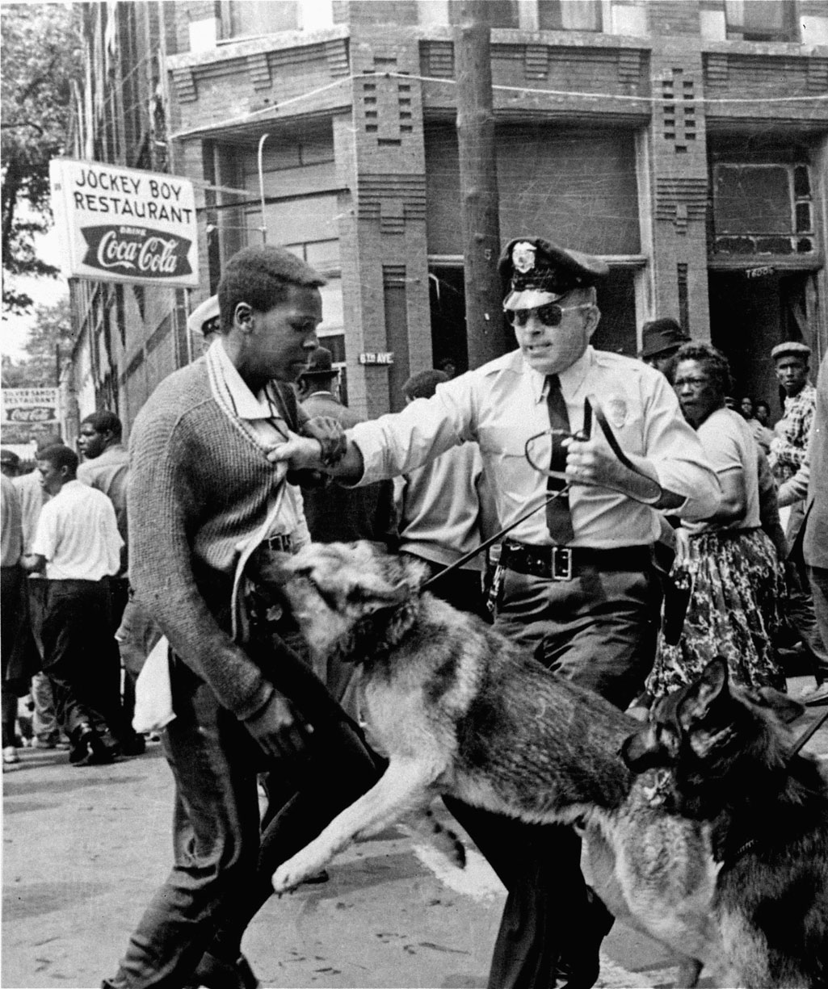
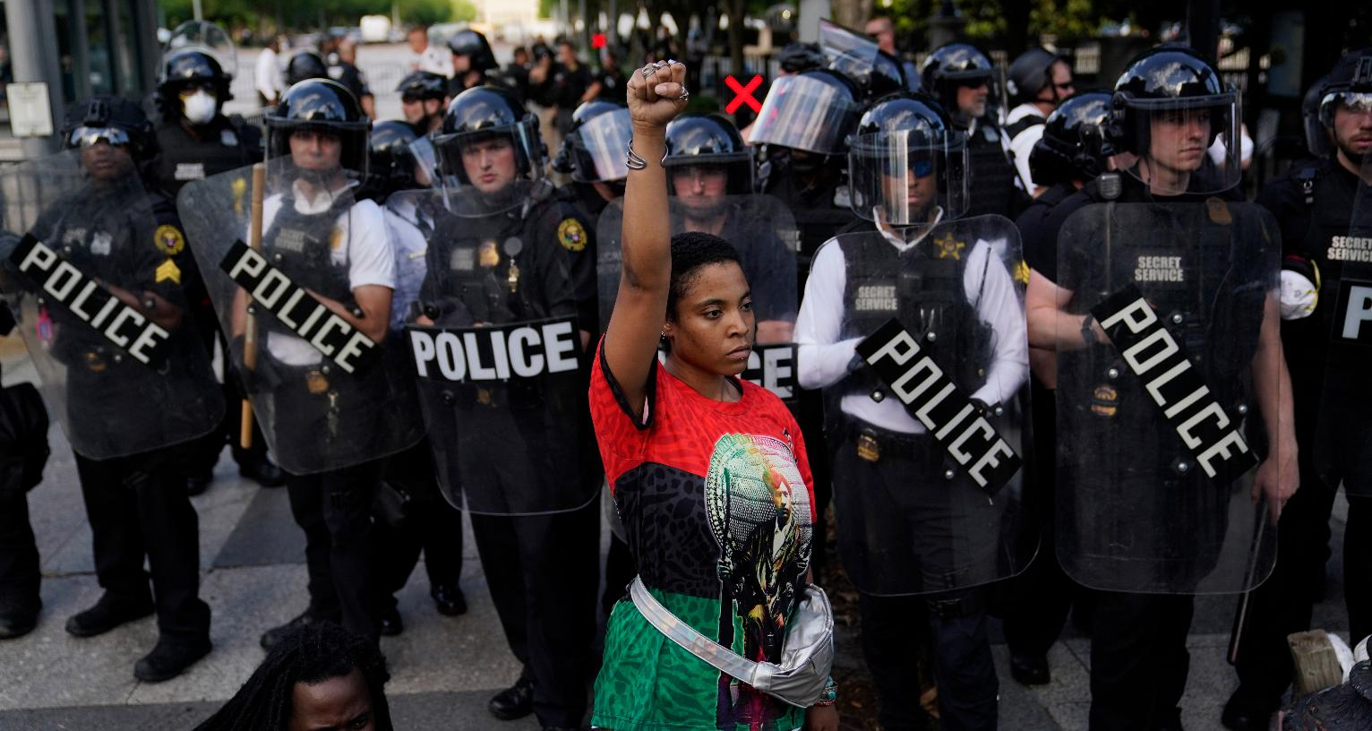
Review of session #3
What is the class nature of the state
and how to fight it

Slide 6
What is a strategy?
A plan of action or policy designed to achieve a major or overall aim
We need a strategy
to end poverty
once and for all
We need a strategy
to end capitalism
once and for all
How?

Slide 7
The fundamental dialectic:
Reform vs. Revolution

Slide 8
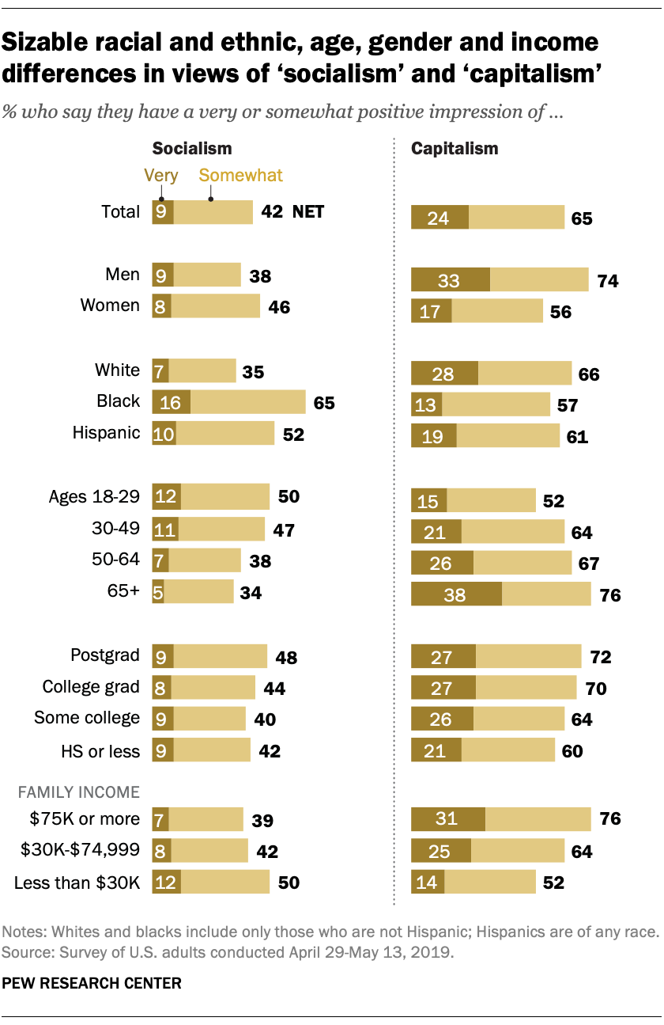
Why socialism?
I am convinced there is only one way to eliminate these grave evils, namely through the establishment of a socialist economy, accompanied by an educational system which would be oriented toward social goals. In such an economy, the means of production are owned by society itself and are utilized in a planned fashion. A planned economy, which adjusts production to the needs of the community, would distribute the work to be done among all those able to work and would guarantee a livelihood to every man, woman, and child. The education of the individual, in addition to promoting his own innate abilities, would attempt to develop in him a sense of responsibility for his fellow men in place of the glorification of power and success in our present society.—Albert Einstein

Slide 9
Strategic tools
1.A vision
2.Organization
3.Leadership
4.A plan

Slide 10
Toward a Strategic Vision
Property: from capitalist to worker controlled
Labor: from unorganized to fully unionized
Government: from plutocracy to dual power
Profit: surplus value used for the public good
Classes: from exploitation to cooperation
Our vision, in our words, for our future

Slide 11
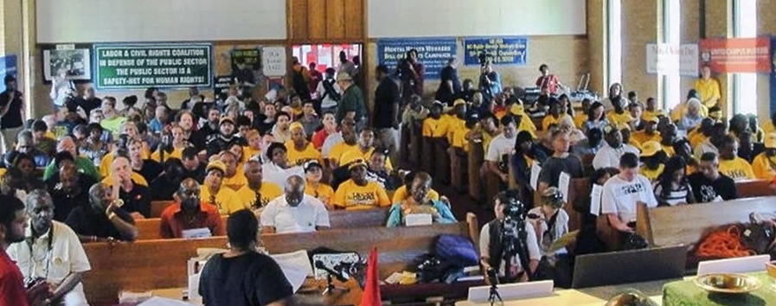
We build Workers Assemblies for workers power
The foundation of our movement is workplace organizations. We link together such organizations in one city, then build unity with the social movements, especially the liberation movements of Blacks, Latinx, and Women.
Workers Unity = Workers Power

Slide 12
A leader is best when people barely know he exists, when his work is done, his aim fulfilled, they will say: we did it ourselves.—Lao Tzu

Slide 13
A strategic plan is composed of tactics
Where are we going? How are we going to get there?
Form a committed core
Key contacts in multiple workplaces
Organize discussions,
identify issues
Organize recruitment to expand the groups
Study the issues and prepare to attack
Recruit a militant minority
Set up local process for
communication
Create a network of multiple workplaces and locations
Create slogans to concentrate political
line, educate, agitate, and mobilize
Plan campaigns of collective action
that unite workers & community activists

Slide 14
Slogans: What are they? How to use them?
MEDICARE FOR ALL Same slogan used 3 ways
Educational Set a curriculum for study
Agitational Organize a consensus
Action Focus mass action

Slide 15
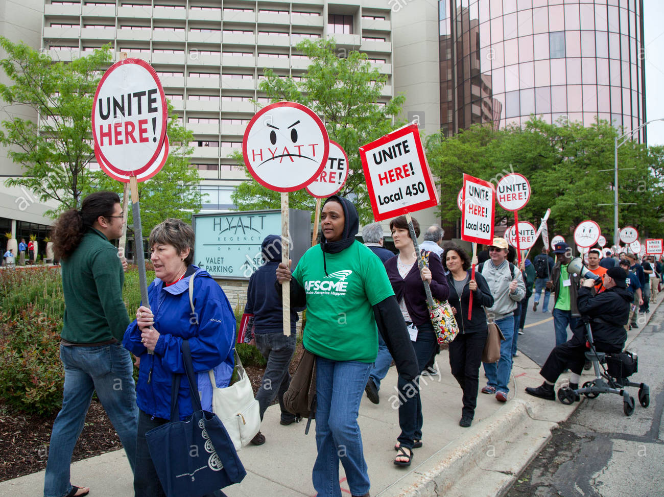
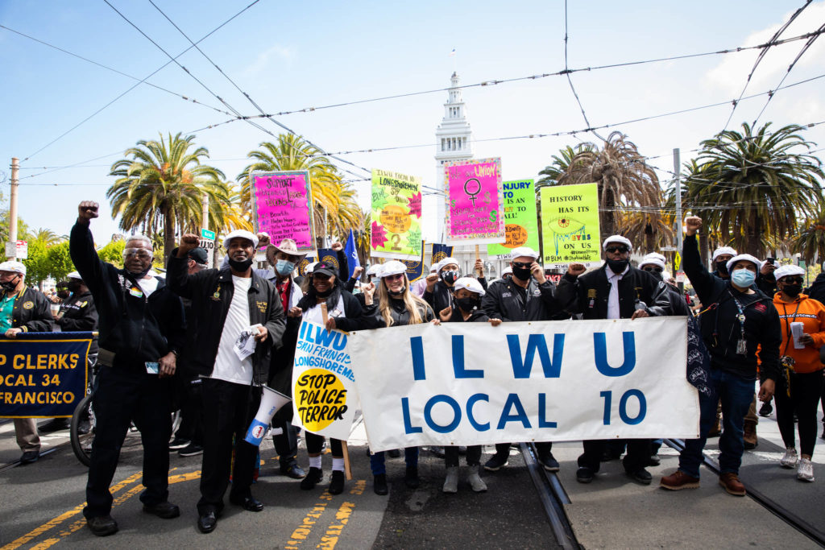
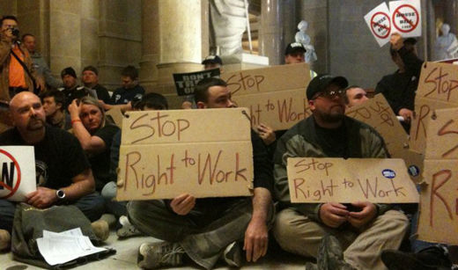
Mass Action is how we exercise
the power of the working class

Slide 16
Anti-Capitalism Struggle
Unite with the Black Liberation Movement

Slide 17
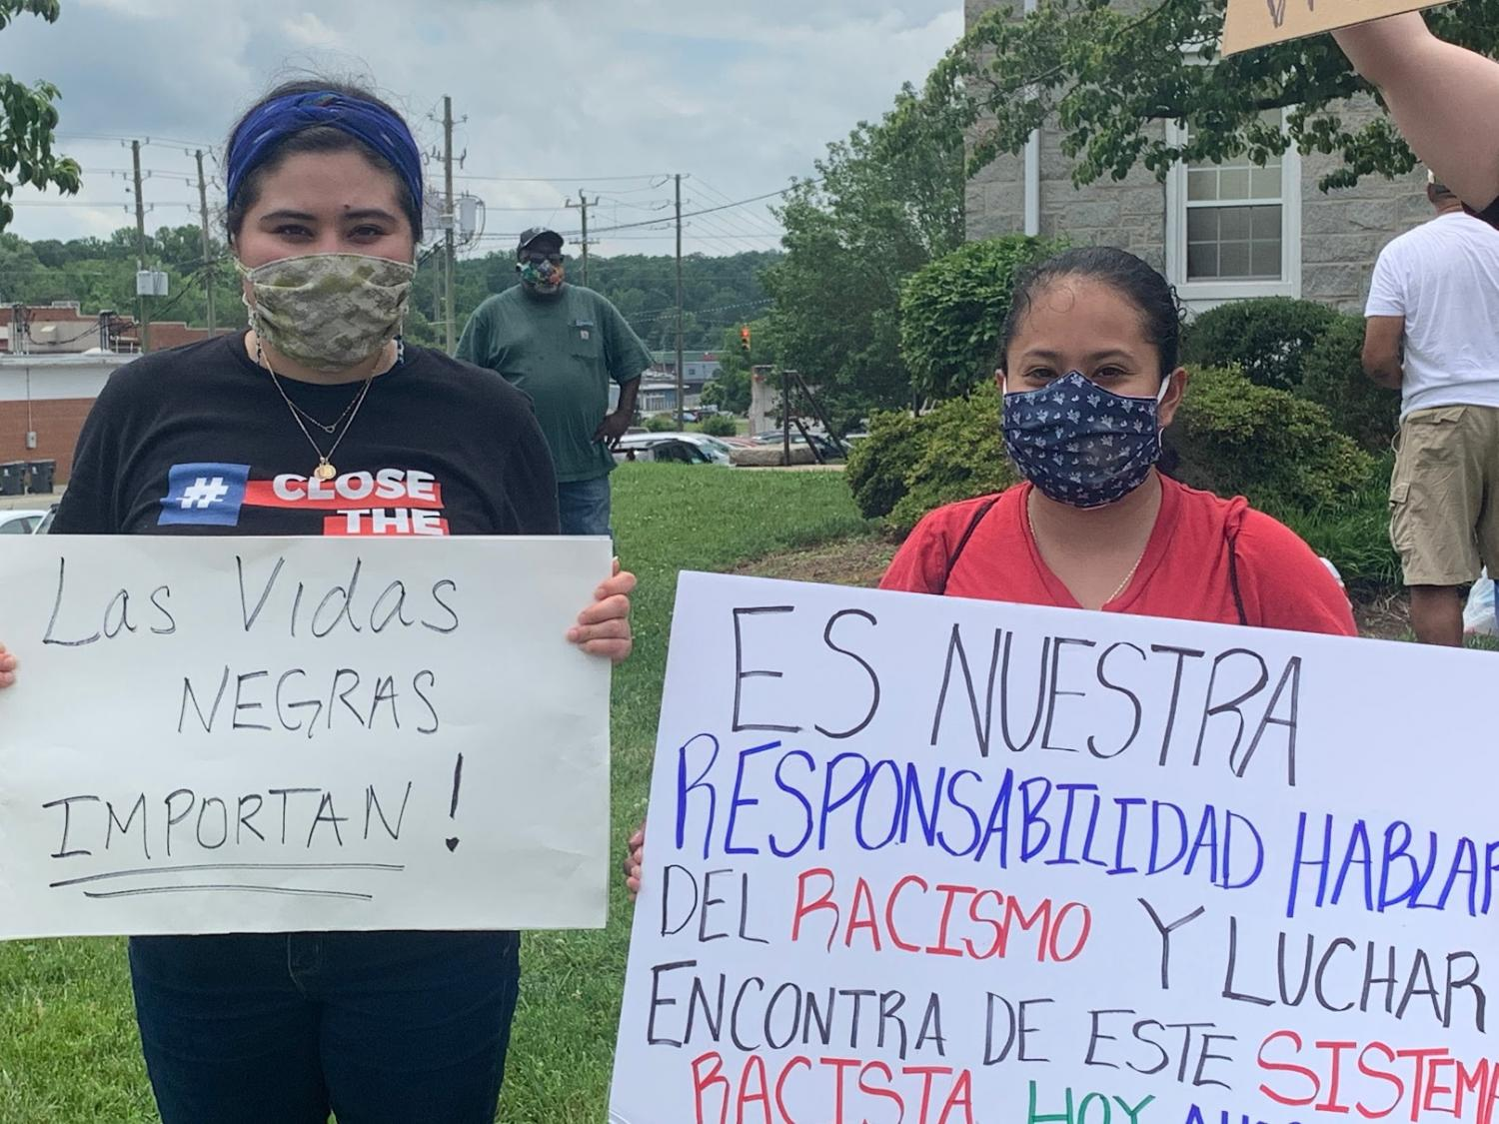
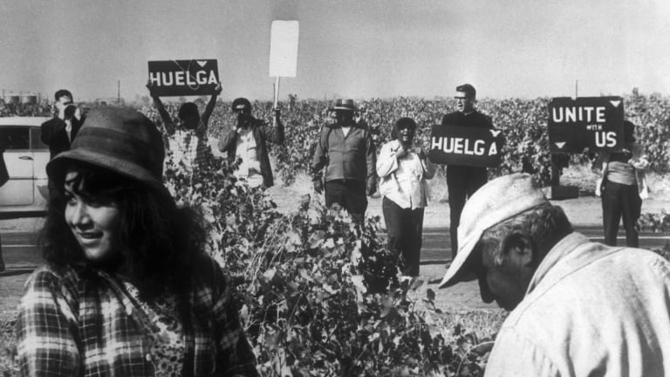
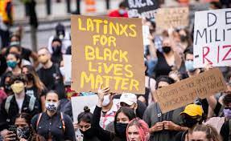
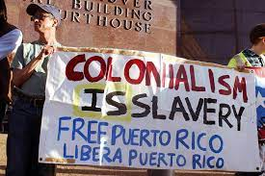
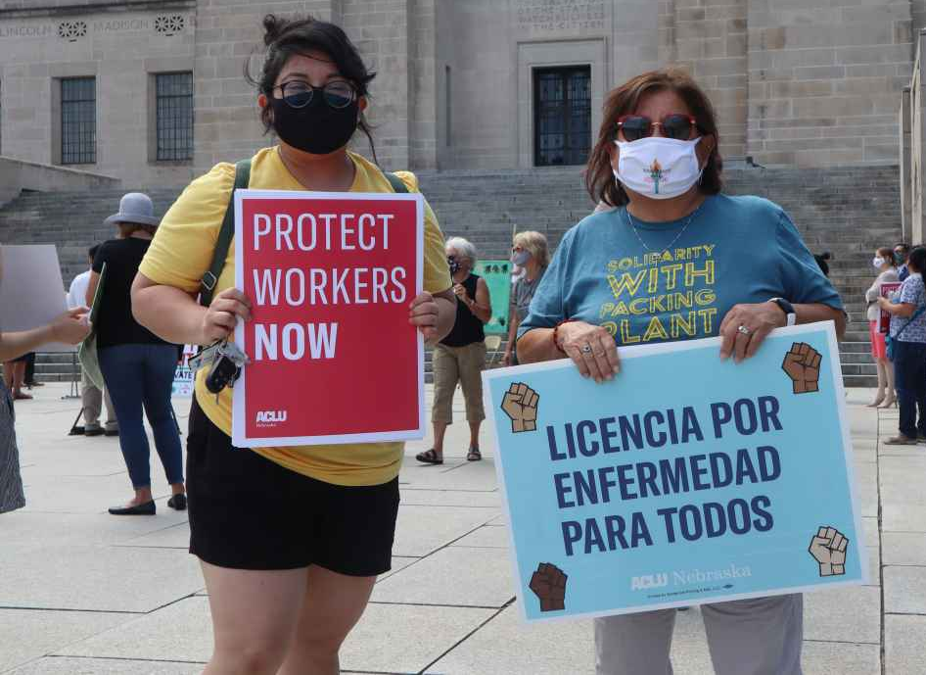
Anti-Capitalism Struggle
Unite with the Latinx Liberation Movement

Slide 18
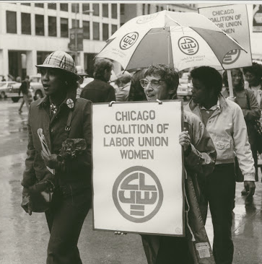
Anti-Capitalism Struggle
Unite with the Women’s Liberation Movement

Slide 19
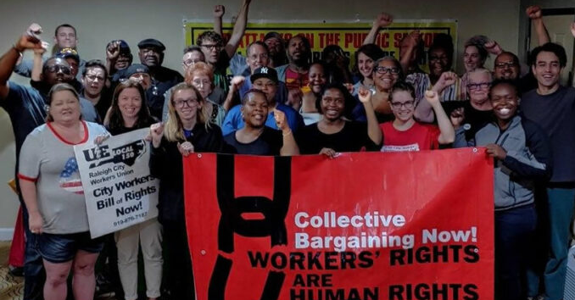
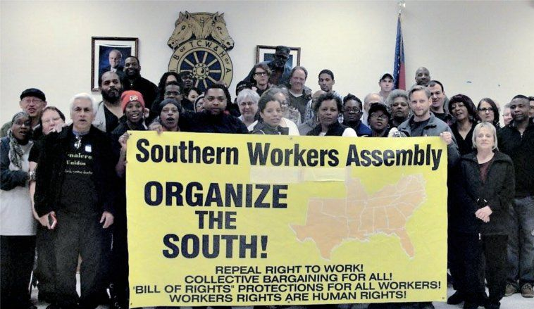
We fight everyday for reforms as part of
the strategic fight for social transformation
Join us!

Slide 20
The future is possible
El futuro es posible
Questions? Comments?

